Slide 1
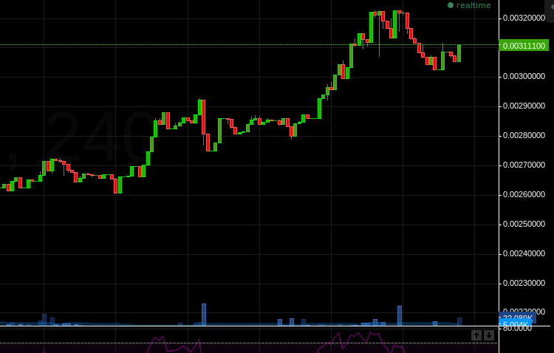







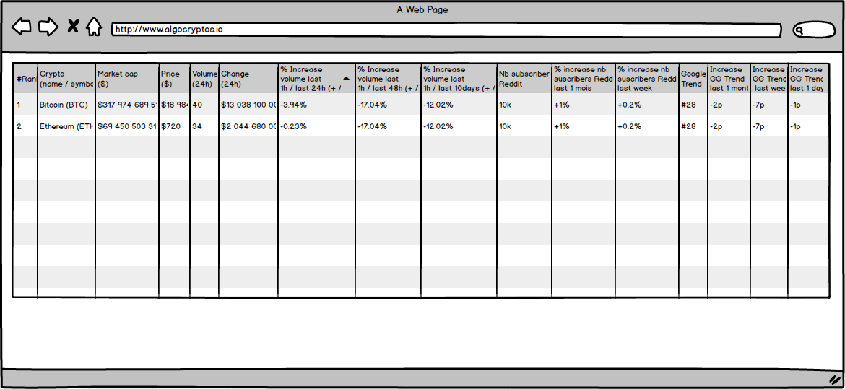




INTERNET
Github
Reddit
CryptoCompare
CoinMarketCap
REST / JSON
DataImporter
PostgreSQL
AlgoKPI
DB
Fronting Web
APINode

